Slide 1
Security
Rasmus Lystrøm
Associate Professor
ITU

Slide 2

Agenda
Security
ASP.NET Core Web API
Blazor
This Photo by Unknown Author is licensed under CC BY-NC-ND

Slide 3
Security

Slide 4
Authentication Options
(None)
(Individual User Accounts)
Azure Active Directory
(Windows)

Slide 5
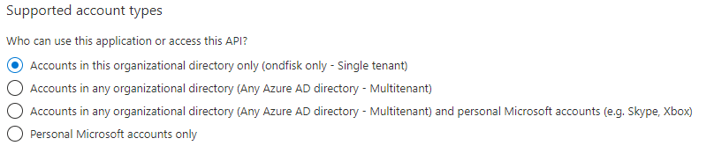
Azure Active Directory (AzureAD/AAD)
Azure Active Directory (Azure AD) is Microsoft’s cloud-based identity and access management service, which helps your employees sign in and access resources in:
External resources, such as Microsoft 365, the Azure portal, and thousands of other SaaS applications.
Internal resources, such as apps on your corporate network and intranet, along with any cloud apps developed by your own organization.

Slide 6
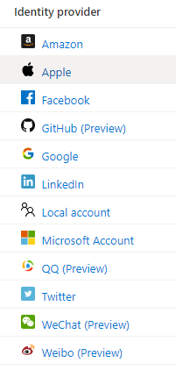
Azure AD B2C

Slide 7
Authentication and Authorization options
(None)
(Individual User Accounts)
Microsoft identity platform
Azure Active Directory
Work or School Accounts (Azure Active Directory)
Windows Authentication (AD)
Azure App Service Authentication (easyauth.dll)
Don’t write your own security layer!

Slide 8
Configure App Registration

Slide 9
Image source: http://lazergaze.tumblr.com/post/26333564955

Slide 10
Security in ASP.NET Core Web API
Demo

Slide 11
Security in Blazor
Demo

Slide 12
Thank You

